Slide 1

IMPACT OF OCCLUSION REMOVAL ON PCA AND LDA FOR IRIS RECOGNITION
DIP Course Project

Slide 2





Team: Visually NSFW
Sarthak Bansal
Krishna Singh
Deeptansh Sharma
Narahari

Slide 3


Iris recognition has long been recognized as a highly reliable and secure biometric authentication method. However, challenges related to occlusions, such as eyelids and eyelashes, have persisted and often hindered the accuracy of iris recognition systems.
Our project primarily focuses on the vital aspect of removing obstructions (occlusion) and how this process affects the accuracy of iris recognition. An iris recognition algorithm ,as described in the research paper, which combines morphological image processing, Principal Component Analysis (PCA), and Linear Discriminant Analysis (LDA) has been implemented to explore this crucial question.
Introduction

Slide 4
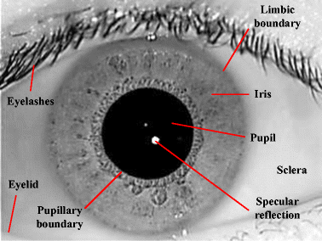

Occlusion removal impact
The human iris possesses a wealth of distinctive features, which makes it an ideal candidate for identity verification. However, when iris images are captured with obstructions like eyelashes and eyelids concealing the iris, the process of identifying individuals using iris recognition can be seriously hindered.
These obstructions introduce challenges in accurately capturing the iris's distinctive patterns, often resulting in reduced recognition accuracy, rendering the technology less reliable in real-world scenarios where such obstructions are common.
However, while using PCA and LDA for the task of iris recognition, it is observed that occlusion removal does not have a significant impact on the success rate.
This claim is to be analyzed by us in this project.

Slide 5

Pre-processing steps
Pupil Segmentation
Iris Segmentation
Iris Normalization
Occlusion Removal
Locating the pupil in the image using morphological image processing.
Identifying the iris part in the image using CHT.
Normalizing the segmented iris image to account for various changes in pupil and iris size.
Eyelash detection and exclusion by parabolic projection.

Slide 6

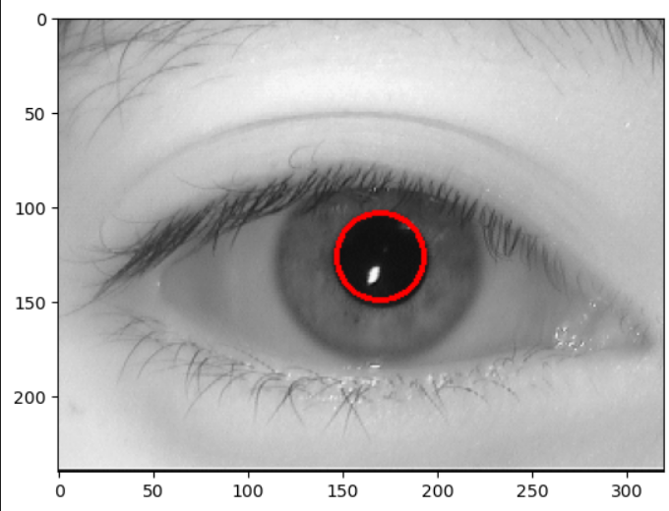
Pupil Segmentation
The pupil, the darkest area within the eye, is typically accompanied by the presence of eyelashes and certain dark patches in the iris. To isolate and delineate the pupil, the following steps are employed:
Inversion of the image is performed, followed by the application of a high threshold. This isolates the darkest portions of the image.
Image is eroded using a circular structural element. This process serves to eliminate any connecting features between the eyelashes and the iris, as well as any dark spots within the iris itself.
The final step involves identifying the largest connected component within the processed image, thereby yielding the precise representation of the pupil.
Result

Slide 7

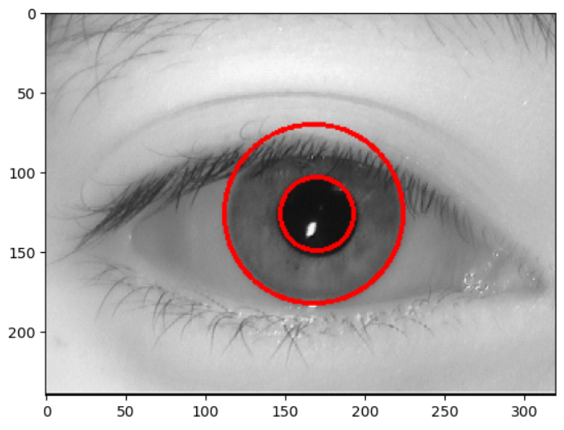
2. Iris Segmentation
To accomplish this, we employ the Circular Hough Transform (CHT) to detect circles that correspond to the iris in the image. The procedure unfolds as follows:
Enhance contrast by applying gamma correction and refine the image using a median filter.
Apply the Hough Transform, using a range of predicted radii. This effectively results in a convolution of the binary image with a range of circles of varying radii.
Among the detected circles, select the one with the maximum radius that is positioned within 20 pixels of the pupil center. This selection provides us with the segmented iris.
Result

Slide 8
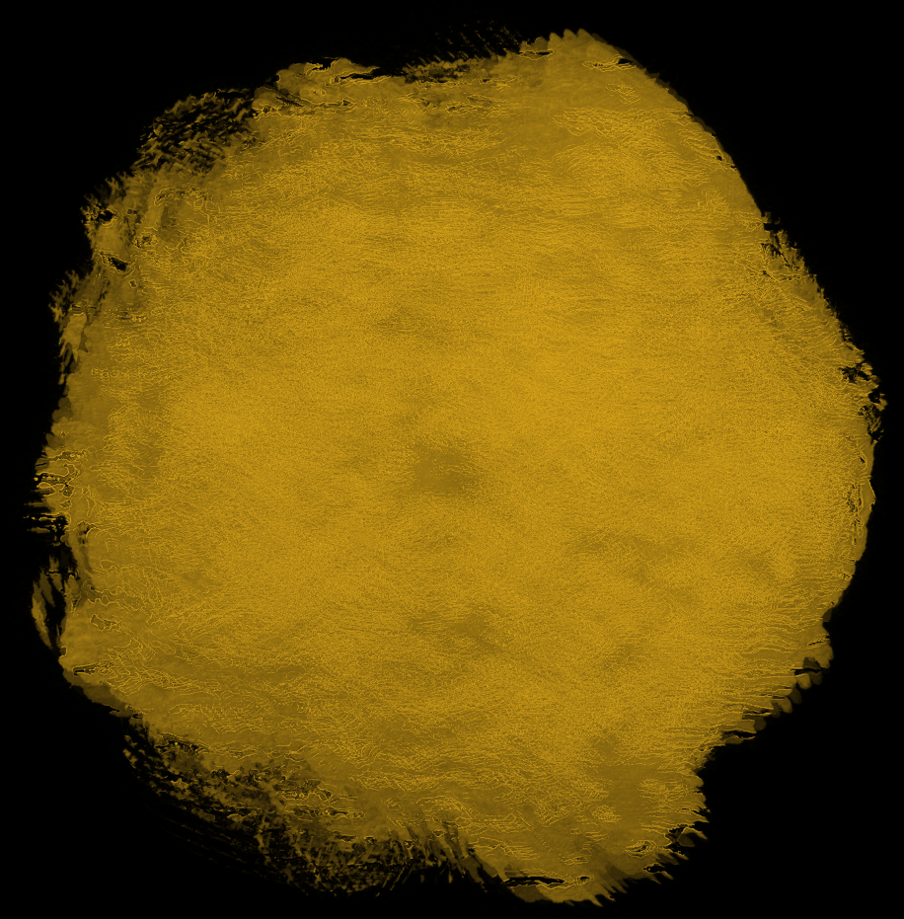
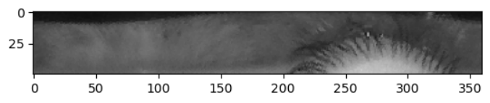
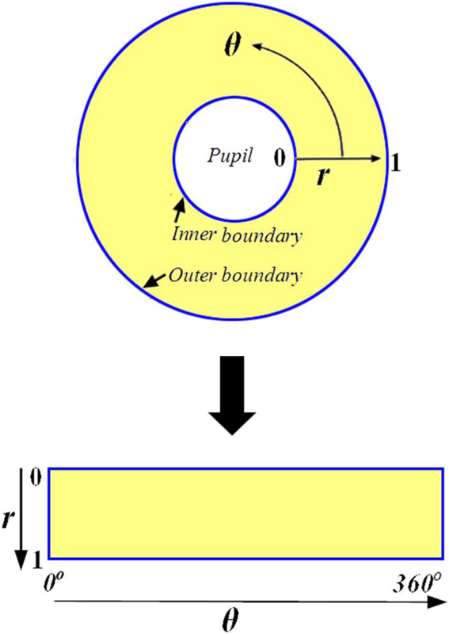
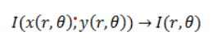
3. Iris Normalization
Result
In this particular phase, the Daugman's rubber-sheet model is deployed, which facilitates the transformation of the iris coordinates into a rectangular format while maintaining the spatial integrity of the iris's inherent features, as visually demonstrated in the preceding illustration.
The image generated after this process still exhibits discernible traces of eyelashes and other occlusions
Daugman’s Rubber Sheet Model

Slide 9

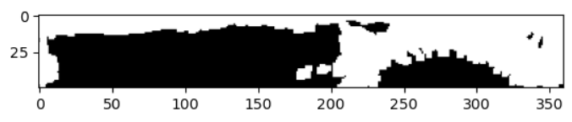
4. Occlusion Removal
Resultant image with occlusion in white
Now here comes the tricky part. We need to detect the eyelash and then remove it from the normalized iris in such a way that we preserve the valuable information of the iris image.
For this task we assume that the projections of eyelash are parabolic and follow the steps outlined below:
Inverting and converting the normalized iris image into binary with a high threshold .
Employing a circular structural element with a small radius to erode the image, effectively eliminating undesired spots within the iris.
Further refining the image by removing connected components consisting of fewer than 10 pixels to eliminate outliers.
Concluding by dilating the image using a square structural element, enhancing its overall appearance.

Slide 10

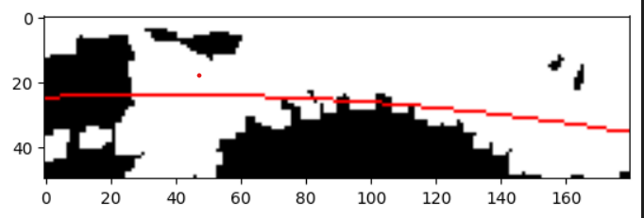
The occlusions are thus marked in the iris image. By parabolic exclusion, occlusions are removed from the image, leaving it with the relevant information required by us.
Exclusion by Parabolic Projection
The image is divided into left and right halves. Canny edge detection algo is applied to both sides and parabolic curves to each half are fitted. Example of parabola drawn on left half is shown in the figure below.
The pixel values in the original image are changed based on the parabolic curves. This process can be used for tasks like separating an object from its background(in this case, occlusions) by excluding pixels that lie inside the expected parabolic shape.

Slide 11
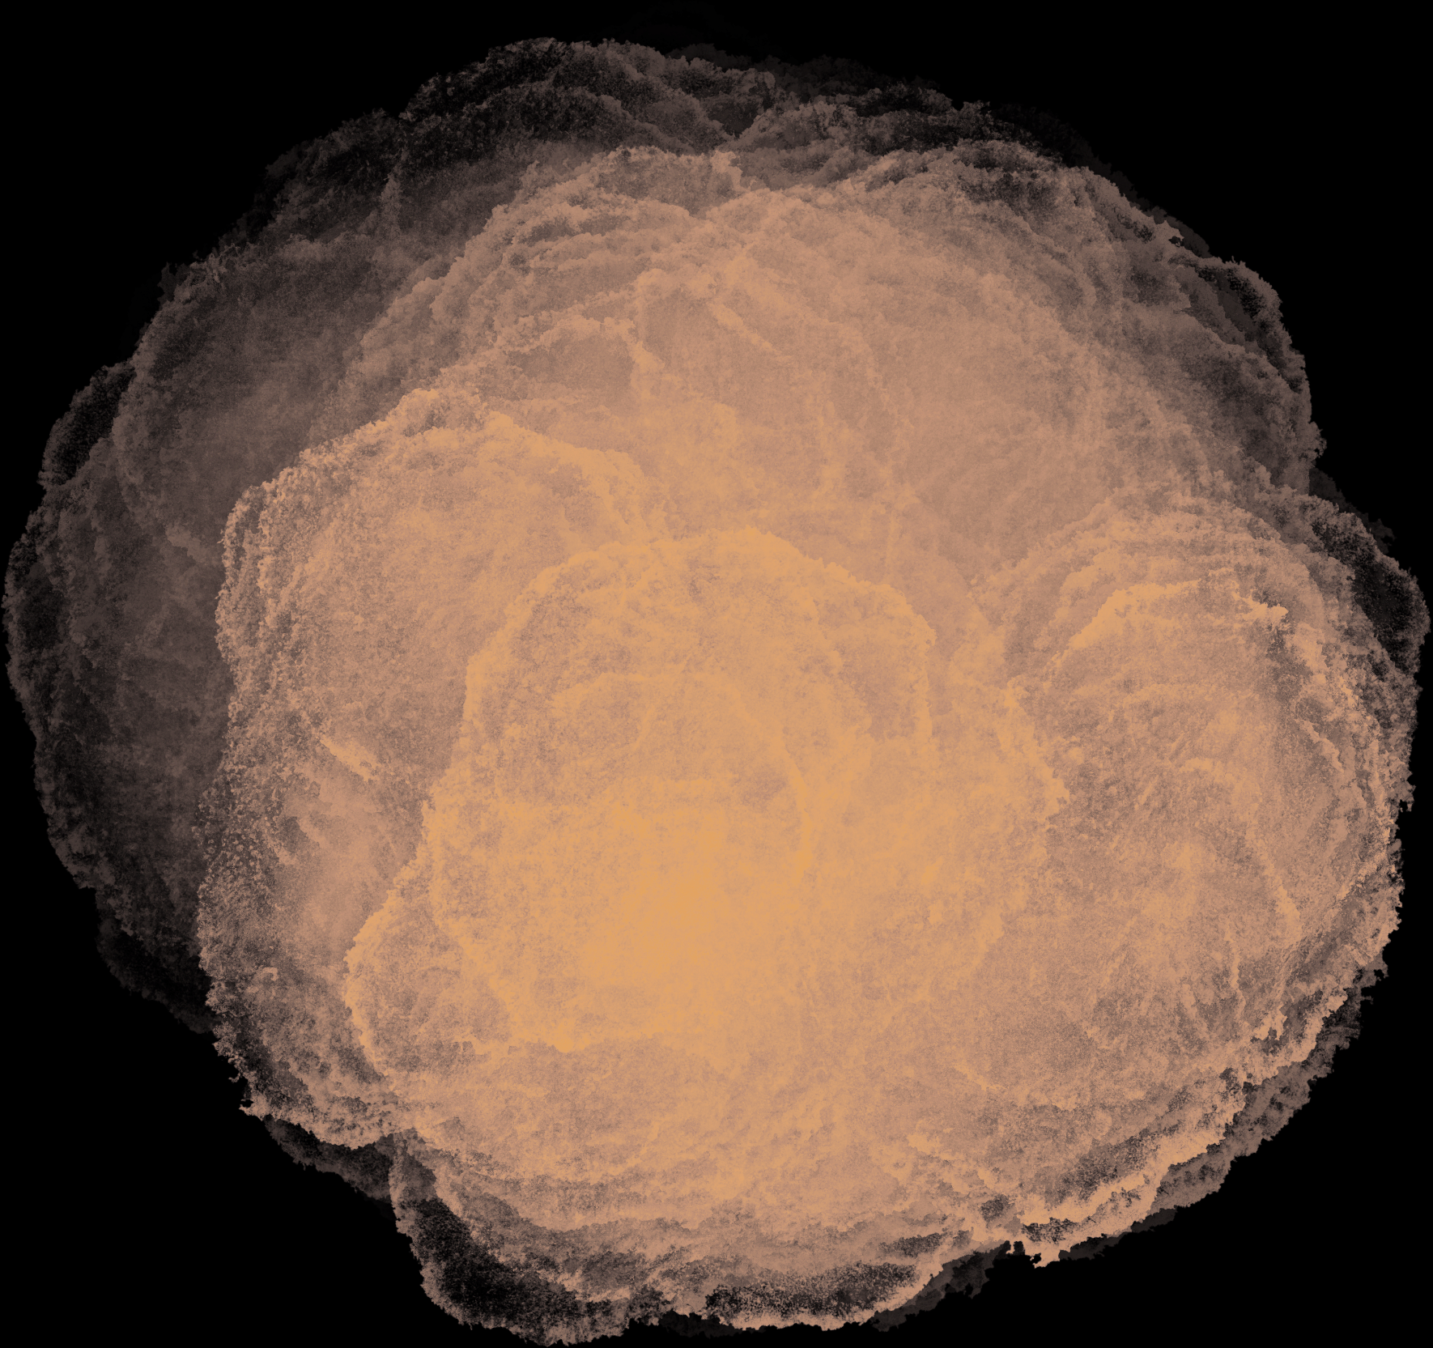
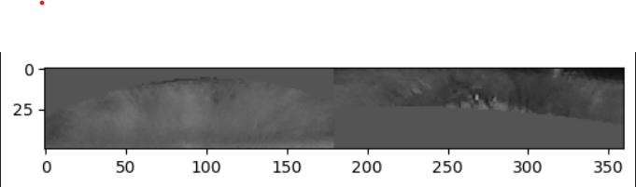
The occlusions are successfully removed by changing the pixel values as explained below:
The mean pixel value of the image is computed. The code then iterates through the columns of the image and calculates the expected y-coordinates on the left and right parabolic curves, which were fitted to the respective halves of the image in earlier steps.
If these y-coordinates fall within the image's height, the code replaces the pixel values in the image under the parabolic curves with the computed mean value.
This process effectively excludes regions of the image that match the parabolic shapes by making those regions uniform in intensity.
Final image after occlusion removal has been depicted in the figure below.
The contrast of the normalized iris can also be improved using histogram equalization.

Slide 12

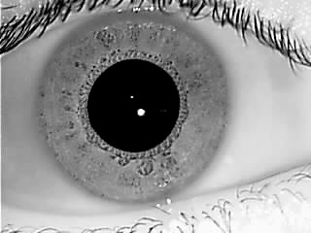
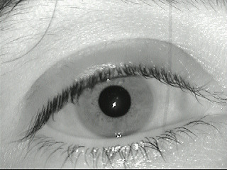
Dataset Used
The dataset used in the paper has clear iris images of 224 people.
To make the project a bit more challenging, we used a separate dataset. It has images of 45 people, which were less clear and had more occlusion. Our methodology is more robust.
Sample image from IITD Dataset (used in the paper)
Sample image from MMU-Iris Dataset (used by us)

Slide 13
Pre-Processing part is done!!!
Now comes the iris recognition part!

Slide 14
Iris Recognition steps
Train-Test Split
PCA Projection
LDA Projection
Label Prediction
The images are split into train-test set with 90% train-set and 10% test-set.
PCA is fit on the training data. The training and test images are projected to a lower dimensional space using this PCA to extract most important features of the data
Further, LDA is applied to the data with similar methodology as PCA. This maximizes the intra-class variance of the data.
The label for test data is predicted using the LDA projections.

Slide 15
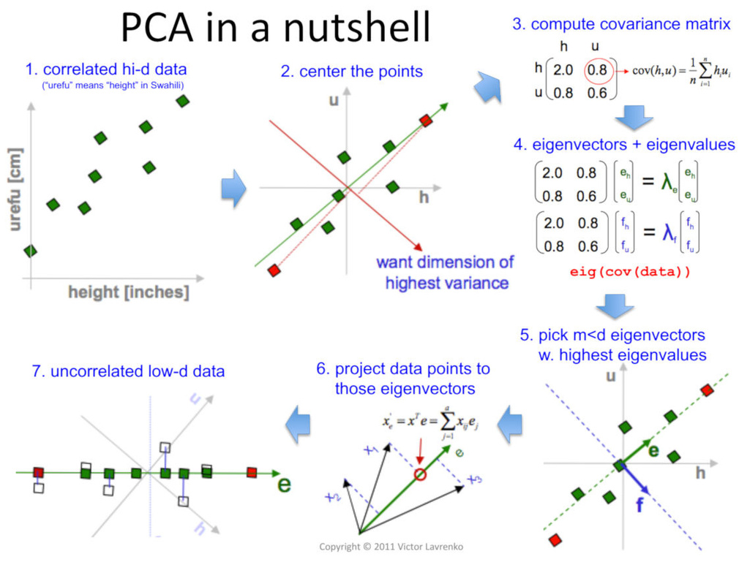
PCA Projection
PCA is a potent technique for reducing the dimensionality of the data while preserving vital information.
The data is projected along axes which capture the maximum variance of the data, as it is important for classification problems such as ours.
The intra-class variance is maximized.
It involves the following steps:
Flattening the images and centering around mean. (Normalizing the data)
Computing covariance matrix and subsequently its eigen values and eigen vectors. The eigen vectors corresponding to higher eigen values are the desired axes for projection.
Finally, we choose the number of axes (Eigen vecs are sorted according to eigen vals, top k ones are taken) which we want to project our data on, and transform our data. (Simple matrix multiplication!!!)

Slide 16

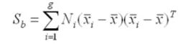
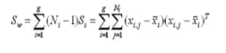
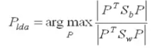
Fischer’s LDA
Linear Discriminant Analysis, or LDA for short, is a predictive modeling algorithm for multi-class classification which also reduces dimensionality of data, providing a projection of a training dataset that best separates the examples by their assigned class, i.e. maximizes intra-class variance.
How does LDA work:
Separability between classes, distance between the mean of different classes, is calculated: Between-class variance.
Calculates the distance between the mean and sample of each class: Within-class variance.
Constructs the lower-dimensional space which maximizes the between-class variance and minimizes the within-class variance. P is considered as the lower-dimensional space projection, also called Fisher’s criterion.
This was the dimensionality reduction aspect!

Slide 17
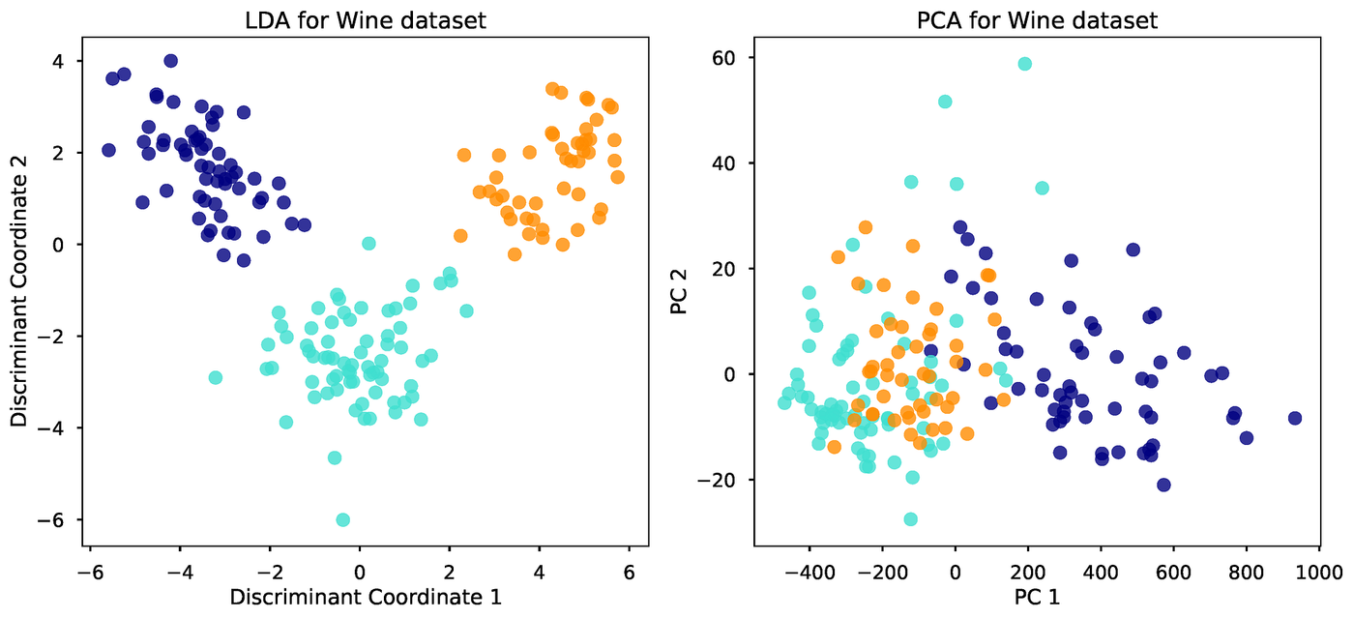
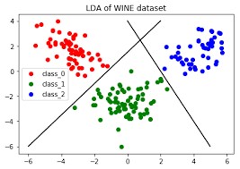
Label Prediction (Recognition!)
The LDA model estimates the mean and variance from data for each class.
Makes predictions based upon the probability that a new input dataset belongs to each class, using Bayes’ Theorem.
Highest probability class is considered the output predicted label.
This was the predictive modeling algorithm aspect!

Slide 18
Putting it all to test!!!

Slide 19
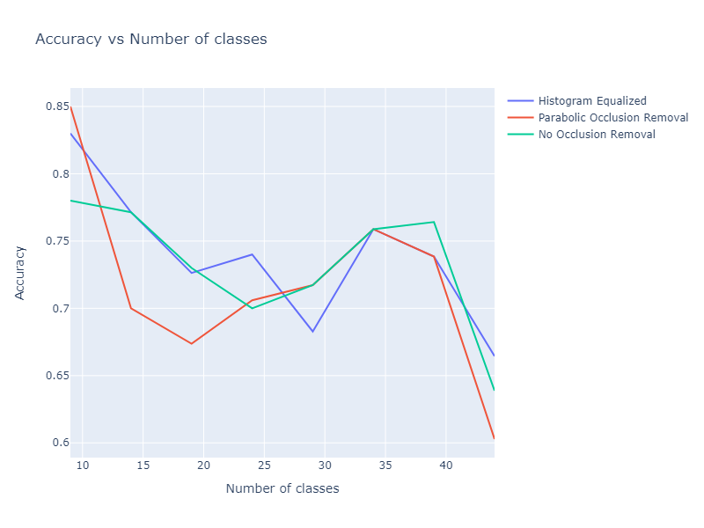
Accuracy vs Number of classes
Plotted Accuracy vs Number of classes of data for the three cases:
No Occlusion removal
Occlusion removal through parabolic projection.
Histogram Equalized image (after occlusion removal)

Slide 20

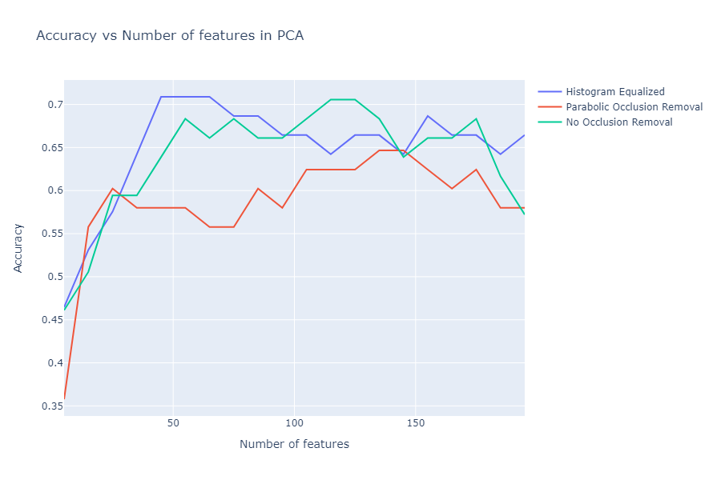
Accuracy vs PCA Features
Plotted Accuracy vs Number of features of PCA for three cases:
No Occlusion removal
Occlusion removal through parabolic projection.
Histogram Equalized image (after occlusion removal)

Slide 21
Conclusion
Occlusion removal has little or no impact on an iris recognition algorithm that uses PCA and LDA. This can provide some benefits to an application, as the occlusion removal steps can be removed, as long as an image of the iris is captured correctly.

Slide 22



